Slide 1

Wide Area Networks
CHAPTER 11

Slide 2
Learning Objective(s) and Key Concepts
Learning Objective(s)
Key Concepts
Describe wireless and wide area networking used to increase business productivity.
Wide area network (WAN) business drivers
WAN technologies
WAN solutions for enterprise, small to medium business (SMB), and small office/home office (SOHO) organizations

Slide 3

WANs and Service Providers
Wide area network (WAN)
Connectivity between multiple locations, an over the Internet
Must be properly sized and affordable
Must allow for growth and be able to scale for more users, data, and transmissions
High-speed Internet and Metro Ethernet connectivity available to businesses and residences today
Software-defined WAN (SD-WAN)
Enables customer to control and configure WAN using point-and-click interface
Requires physical connection to be preinstalled

Slide 4
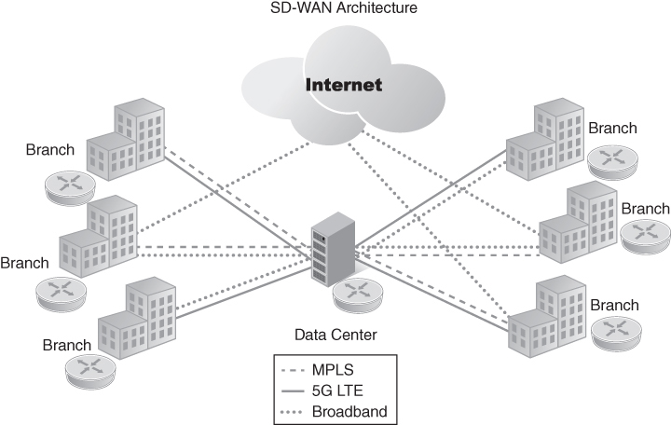
SD-WAN Architecture
FIGURE 11-1 SD-WAN architecture.

Slide 5
WAN and SD-WAN Business Drivers
Need to support cloud migration
Need to enhance network security
Must support network agility
Must have network visibility
Must be affordable and provide a return on investment (ROI)

Slide 6
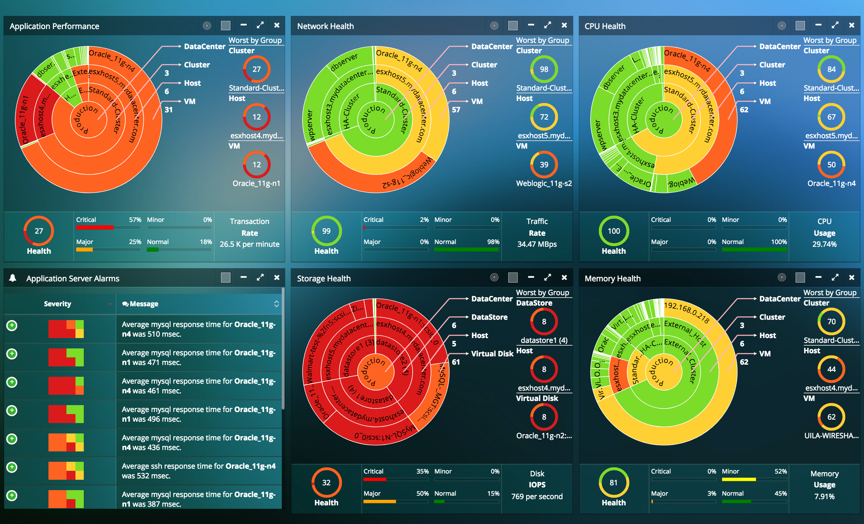
Network Visibility
The term used for the collection, aggregation, distribution, and analysis of data traffic flows within and across a network.
With network visibility, you can have great control over network traffic, application, network performance, data analytics, and network resources.
This way, you can make informed decisions regarding the traffic and protection of data.

Slide 7
What are the Benefits of Network Visibility?
Monitor and Limit Bandwidth Abuse:
It let you monitor and control users, devices, and applications.
If you have more employees or applications in your network, network visibility will let you monitor that source and adjust their access accordingly.
With a better understanding of bandwidth usage, you can create a better quality of service policy.
Minimized Downtime:
A detailed view of your entire network lets you locate the source of any problem.
Visibility means you can examine problems before they affect your network.

Slide 8
What are the Benefits of Network Visibility?
Risk Prevention:
It also helps to detect threats and identify abnormal network behavior.
With improved network visibility, you can view threats and create a security plan accordingly.
For example, unauthorized access can be tracked whenever it happens.
The same thing goes for detecting malware within encrypted network traffic.
You can create and analyze network logs and security devices.
Efficient Troubleshooting:
The proactive issue detection system can be planned with network intelligence.
Instead of randomly detecting issues, a network admin can troubleshoot the issues with a more detailed and focused approach.

Slide 9
WAN Technologies in the 1970s
Modem
A device that transmits and receives signals via tones
Modulation and demodulation is a technique for transmitting 1’s and 0’s over an analog transmission line
Modem transmission speeds peaked at 56 Kbps when analog dial-up services were deployed for initial Internet access
Analog leased lines or circuits
Provide a point-to-point transmission path
Connection is always on

Slide 10
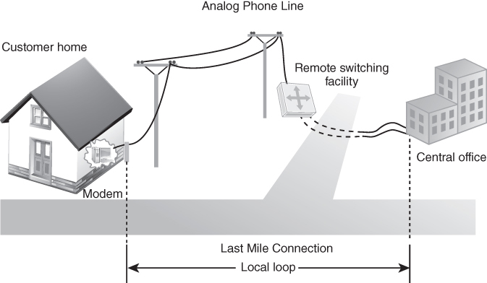
Analog Modem WAN Connectivity Through the PSTN
FIGURE 11-2 Analog modem WAN connectivity through the PSTN.
Data from ComplianceForge.com.

Slide 11
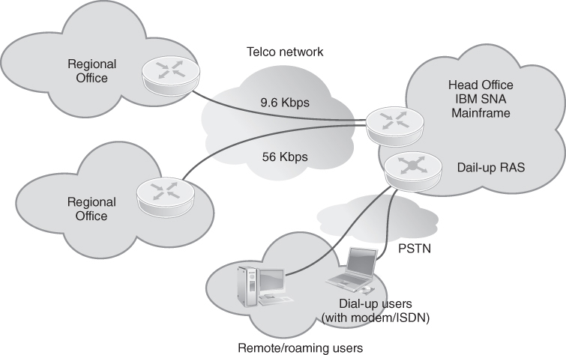
Leased Lines for WAN Connectivity
FIGURE 11-3 Leased lines for WAN connectivity.

Slide 12


WAN Technologies in the 1980s
Circuit-switched networks
Public Switched Telephone Network (PSTN)
Integrated Services Digital Network (ISDN) – It Still Does Nothing
Packet switches
Derive the best path to take within the packet-switched network to reach the destination via virtual circuits
Digital transmission switches
Deployed by service providers
Replaced analog transmission switches
Support the DS0/DS1/DS3 family of digital communications
Satellite communications
Provide the equivalent of a leased line

Slide 13
Digital Signal Zero
DS0 stands for Digital Signal Zero, and it is a standard digital transmission rate for digital telecommunications.
DS0 defines a transmission rate of 64 Kbps and can carry either a single voice channel or data.
Telecommunication carriers transmit digital signals in multiples of DS0 called DS1, DS2, and so on.
These multiples differ depending on whether you are dealing with the T-carrier system of North America or the E-carrier system of Europe and other continents.

Slide 14
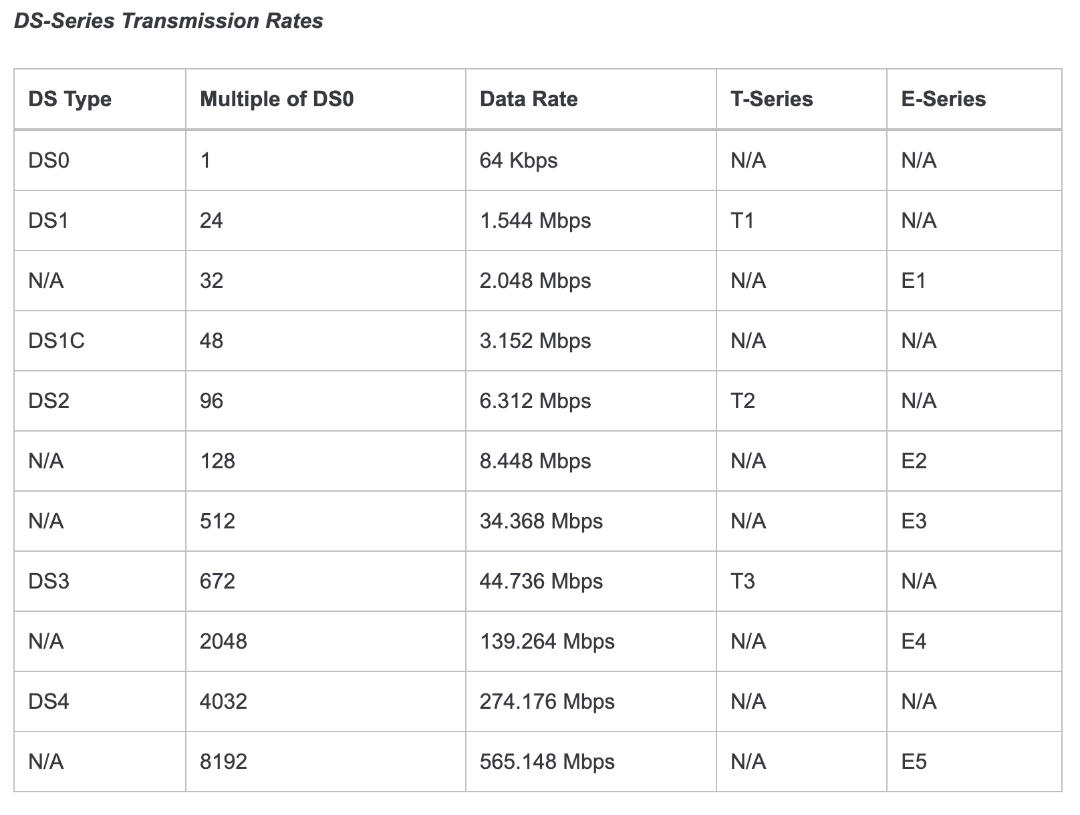
Digital Signal Zero

Slide 15
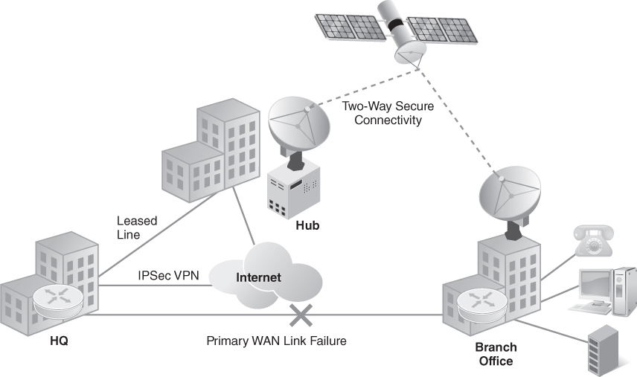
Satellite WAN Connectivity
FIGURE 11-5 Satellite WAN connectivity.

Slide 16
WAN Technologies in the 1990s
Use of optical fiber and SONET backbone networks
Asynchronous Transfer Mode (ATM)
Solution for high-speed transport services for voice, video, and data transmissions
Switches establish point-to-point connections between endpoints to support data transmission

Slide 17
WAN Technologies in the 2000s
Synchronous Optical Network (SONET)
A standard for high-speed optical fiber backbone networks
Synchronous digital transmissions
Deployed by service providers in a ring topology
Multiprotocol Label Switching (MPLS)
A packet-switching technology that operates at Layer 2 and does not route at Layer 3
Service providers adopted MPLS switches for use as enterprise WAN solutions
Allows IP traffic to flow in a full or partial mesh configuration
Supports Quality of Service (QoS) and Class of Service (CoS)

Slide 18
Synchronous Optical Network (SONET)
SONET stands for Synchronous Optical Network.
SONET is a communication protocol, developed by Bellcore – that is used to transmit a large amount of data over relatively large distances using optical fiber.
With SONET, multiple digital data streams are transferred at the same time over the optical fiber.
SONET defines optical signals and a synchronous frame structure for multiplexed digital traffic
It is a set of standards that define the rates and formats for optical networks specified in ANSI T1.105, ANSI T1.106, and ANSI T1.117.

Slide 19
Synchronous Optical Network (SONET)
A similar standard, Synchronous Digital Hierarchy (SDH), is used in Europe by the International Telecommunication Union Telecommunication Standardization Sector (ITU-T).
SONET equipment is generally used in North America, and SDH equipment is generally accepted everywhere else in the world.
Both SONET and SDH are based on a structure that has a basic frame format and speed.
The frame format used by SONET is the Synchronous Transport Signal (STS), with STS-1 as the base-level signal at 51.84 Mbps.
An STS-1 frame can be carried in an OC-1 (Optical Carrier level 1) signal.
The frame format used by SDH is the Synchronous Transport Module (STM), with STM-1 as the base-level signal at 155.52Mbps.
An STM-1 frame can be carried in an OC-3 signal.

Slide 20
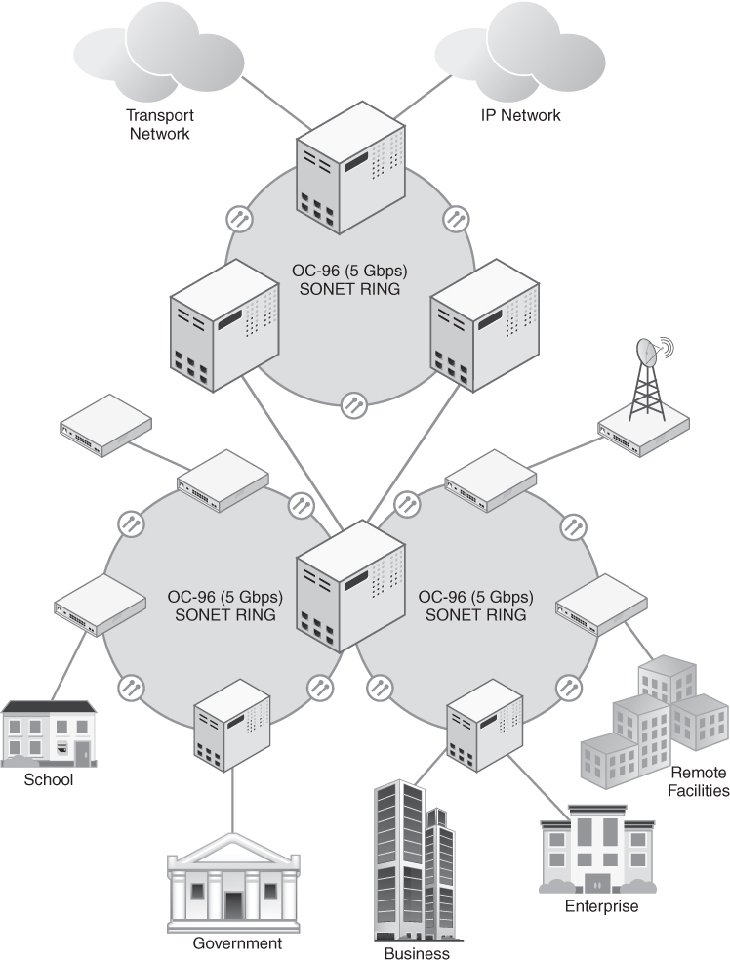
SONET Backbone Network Architecture
FIGURE 11-6 SONET backbone network architecture.

Slide 21
Asynchronous Transfer Mode
It is a switching technique that uses time division multiplexing (TDM) for data communications.
ATM networks are connection oriented networks for cell relay that supports voice, video and data communications.
It encodes data into small fixed - size cells so that they are suitable for TDM and transmits them over a physical medium.
The size of an ATM cell is 53 bytes: 5 byte header and 48 byte payload.
There are two different cell formats - user-network interface (UNI) and network-network interface (NNI)

Slide 22
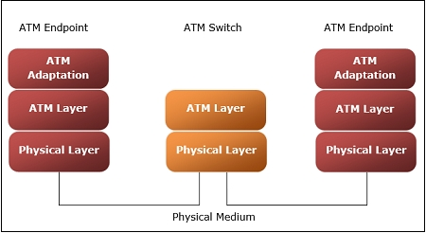
ATM reference model comprises of three layers
Physical Layer − This layer corresponds to physical layer of OSI model.
At this layer, the cells are converted into bit streams and transmitted over the physical medium.
This layer has two sub layers: PMD sub layer (Physical Medium Dependent) and TC (Transmission Convergence) sub layer.
ATM Layer −This layer is comparable to data link layer of OSI model.
It accepts the 48 byte segments from the upper layer, adds a 5 byte header to each segment and converts into 53 byte cells.
This layer is responsible for routing of each cell, traffic management, multiplexing and switching.

Slide 23
ATM Adaptation Layer (AAL) −This layer corresponds to network layer of OSI model.
It provides facilities to the existing packet switched networks to connect to ATM network and use its services.
It accepts the data and converts them into fixed sized segments.
The transmissions can be of fixed or variable data rate.
This layer has two sub layers − Convergence sub layer and Segmentation and Reassembly sub layer.
ATM endpoints − It contains ATM network interface adaptor.
Examples of endpoints are workstations, routers, CODECs, LAN switches, etc.
ATM switch −It transmits cells through the ATM networks.
It accepts the incoming cells from ATM endpoints (UNI) or another switch (NNI), updates cell header and retransmits cell towards destination.

Slide 24
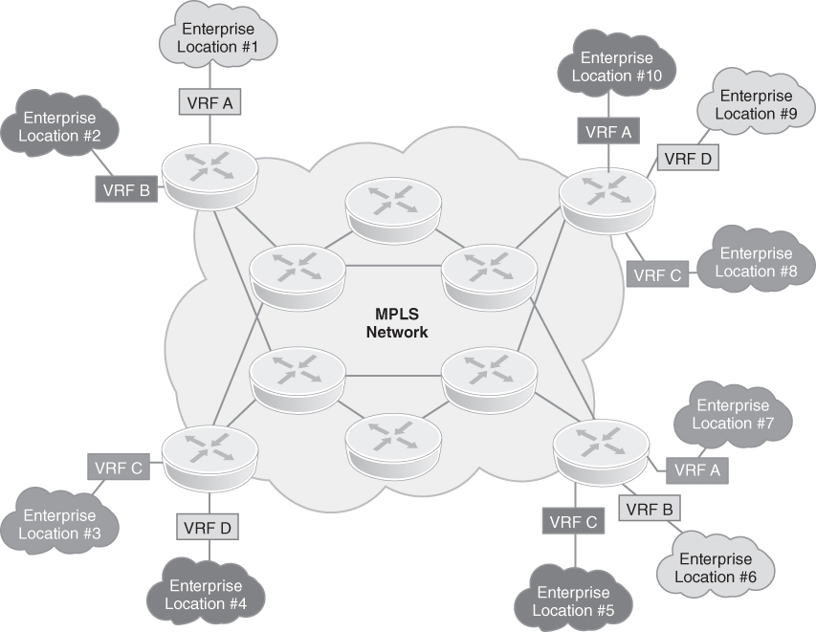
MPLS WAN Connectivity
FIGURE 11-7 MPLS WAN connectivity.

Slide 25
MPLS
MPLS is a highly customizable way of connecting sites.
It is virtually private, meaning that it feels like you have your own, private, network between the sites.
The provider offering you MPLS takes care of everything in-between your two sites so that it is transparent to you.

Slide 26
The advantages of MPLS
It is a true private network.
Even if the provider runs your MPLS in the same hardware where they also run MPLS networks of other customers, you have your own and isolated virtual domain.
Providers can grant you upload and download bandwidth.
It is subject to Service Level Agreements, meaning that if the bandwidth is not granted or if the link is unavailable up to a level that breaches the agreement, you can get a partial refund.
MPLS support Quality of Service (QoS), meaning that you can ensure the right business applications get the right amount of bandwidth during peak hours

Slide 27
The disadvantages of MPLS
MPLS is extremely expensive. SLA, QoS, granted bandwidth and all its features are not free.
Since MPLS has a great level of customization, it also has a great level of complexity.
Most of it is inside the provider, and you don’t see it (but it will cost you).
However, you still need to have some networking IT skills to connect your sites to the MPLS.

Slide 28
How does MPLS work?
An MPLS network, just like any other network, is a set of routers, devices that forward traffic.
You have three types of routers in MPLS:
Customer Edge (CE) is the router that resides in the customer facilities.
Is the last device managed by the customer before entering the provider domain.
However, since the CE holds a lot of complexity, many providers offer a server of “managed CE”, where they take care of this router as well.
Provider Edge (PE) is the first provider’s router.
Many CEs connect to the same PE, which aggregates them.
Provider Router (P) is at the core of the provider and forwards packets based on MPLS labels.

Slide 29
MPLS forwarding in detail
How do these routers integrate?
If you have two sites that want to communicate, the traffic will go to the CE of the originating site.
The CE applies some settings, like the Quality of Service, and sends the traffic to the PE, that receives the packet on a dedicated VRF.
A VRF is a virtual instance of the router, and each customer has its own, so that no customer can see the traffic of other customers.
The PE router puts an MPLS label in the packet, and send it to the P router.
All P routers along the path will forward the packet based on the MPLS label, without knowing any information about the customer’s addressing.
In the end, the packet will reach another PE.

Slide 30
MPLS forwarding in detail
Using the MPLS label, the PE is able to remove that label and put the packet back in the right VRF domain.
Then, it forwards the packet to the connected CE.
It is common to have a flat MPLS network.
In this design, even if the provider’s network is complex, you feel like a huge switch: all sites can speak with all other sites over MPLS.

Slide 31
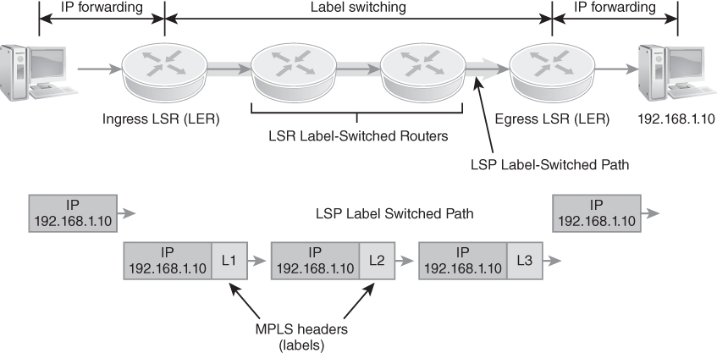
Label-Switched Routers (LSRs) in an MPLS WAN
FIGURE 11-8 Label-switched routers (LSRs) in an MPLS WAN.

Slide 32
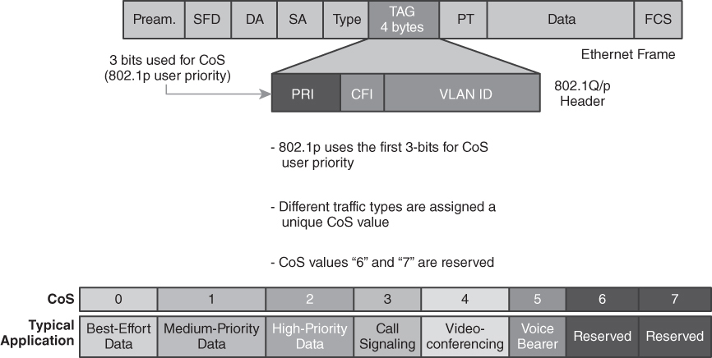
Class of Service (CoS) Identifier
FIGURE 11-9 Class of Service (CoS) identifier.

Slide 33
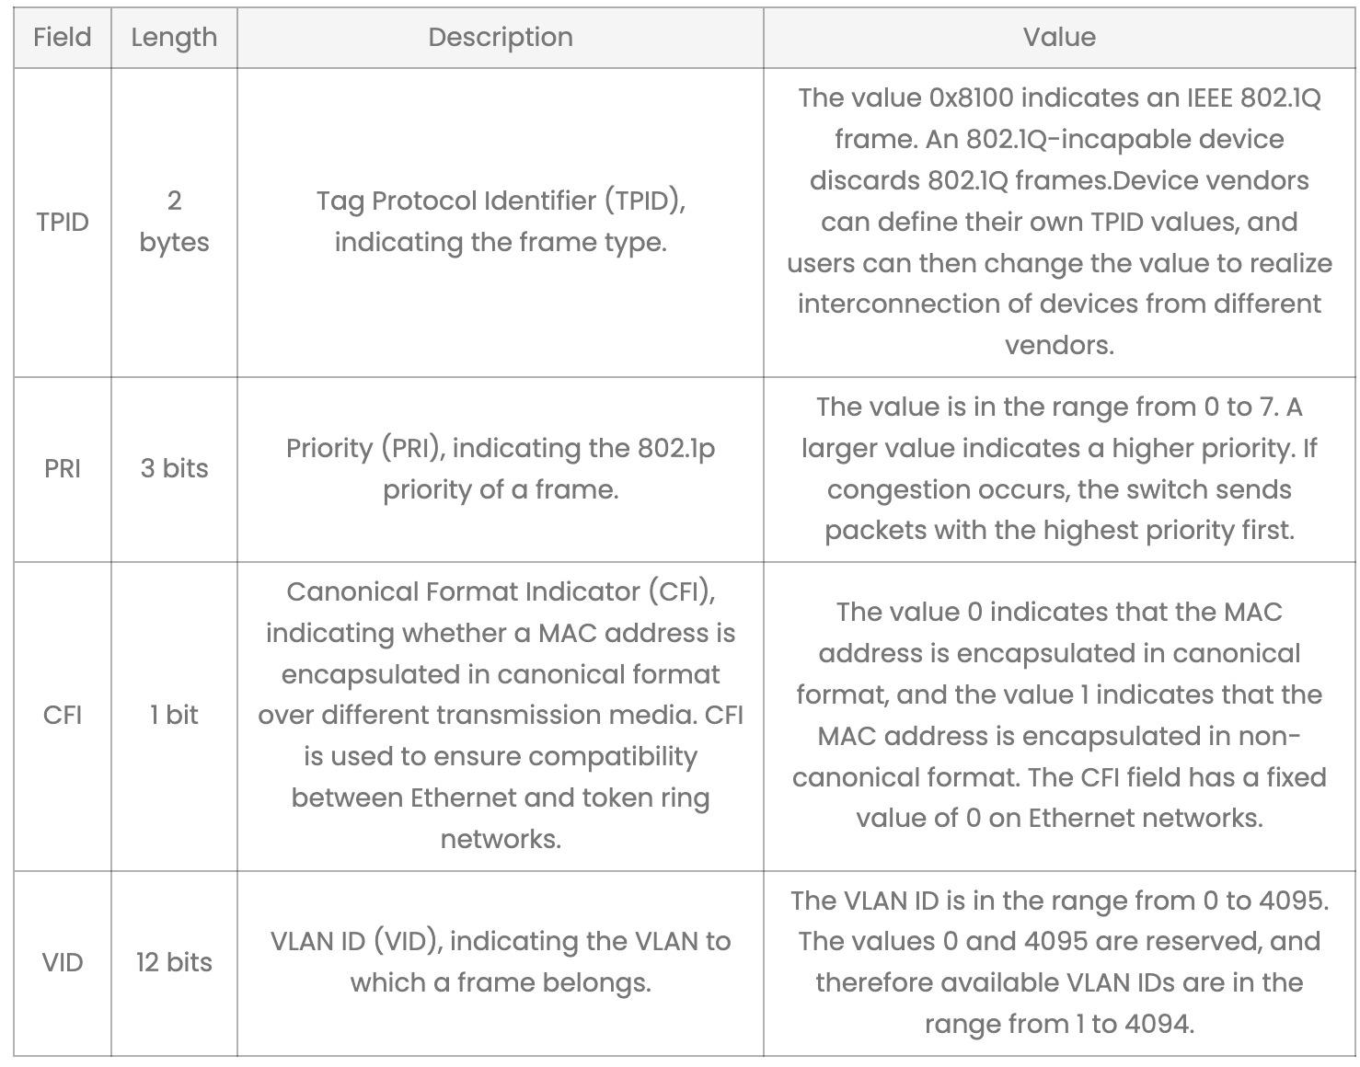
Class of Service (CoS) Identifier

Slide 34
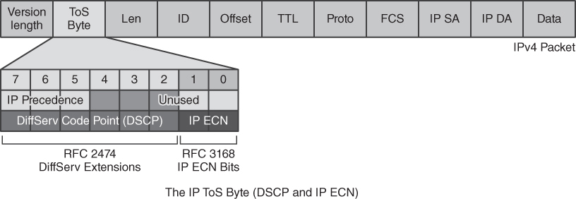
Quality of Service (QoS) Identifier
FIGURE 11-10 Quality of Service (QoS) identifier.

Slide 35
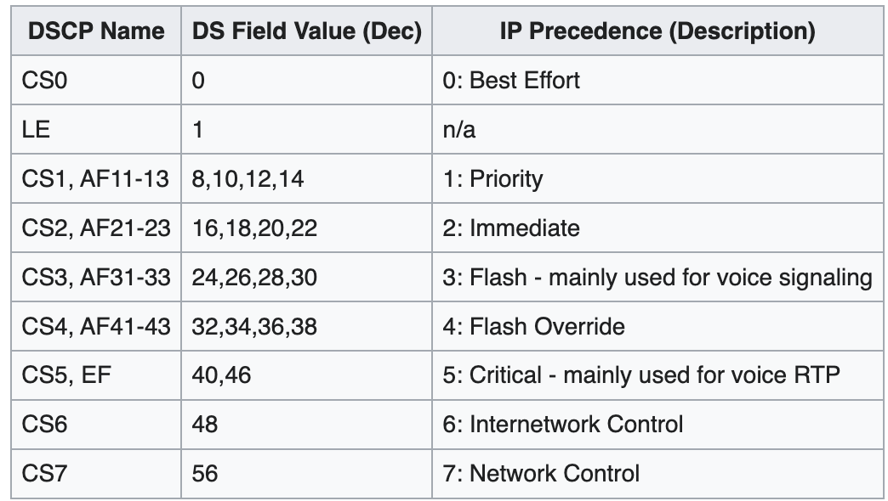
Quality of Service (QoS) Identifier
IP Precedence – Deprecated
DSCP – Differentiated Services Code Point
ECN – Explicit Congestion Notification
CS – Class Selector
EF – Expedited Forwarding
LE – Lower Effort

Slide 36
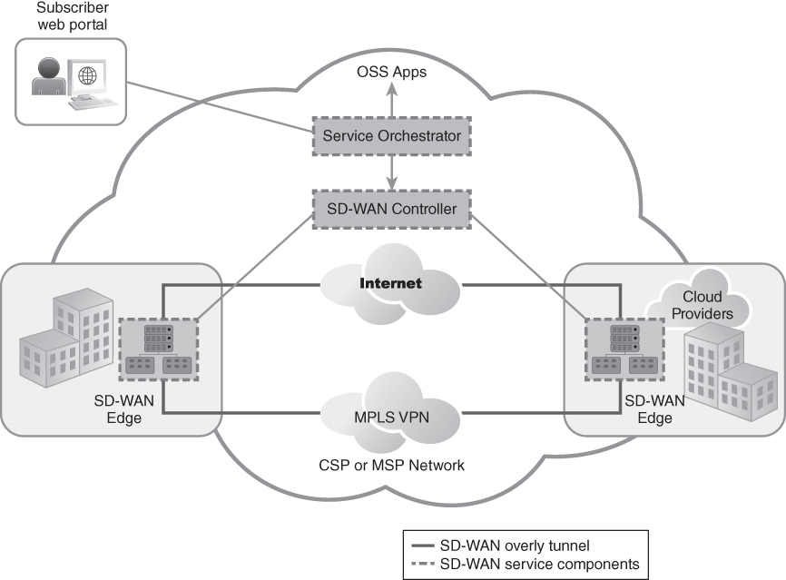
WAN Technologies in the 2010s: SD-WAN
FIGURE 11-12 SD-WAN service components.

Slide 37
WAN Technologies in the 2010s: SD-WAN
SD-WANs put configuration and control in the hands of the customer.
Once a digital pipe is installed at a physical endpoint, the customer has full control as to how it is configured.
This includes slicing and dicing the bandwidth, configuring Layer 2 or Layer 3 switching, and enabling security controls.

Slide 38
WAN Management and Requirements
Fault management
Configuration management
Performance management
Security management
Addresses a down or non-functioning link, circuit, or network connection
Pertains to software changes to the WAN and network devices (routers, switches, etc.)
Accounting management
Refers to the ongoing management of third-party vendors and telecom service providers
Deals with optimization, effectiveness, and efficiency of the WAN and its overall performance
Deals with ongoing security operations and management functions

Slide 39
Fault Management Requirements
Fault monitoring
Incident response
Operations
Resiliency
Redundancy
Monthly reporting

Slide 40
Configuration Management Requirements
Configuration identification
Configuration auditing
Change control
Provisioning speed
Ticketing
Version control
Monthly reporting

Slide 41
Accounting Management Requirements
Accounting
Asset inventory and management (WAN)
Audit of service provider billing
Performance monitoring and reporting
Service level agreements (SLAs)
Vendor management
Monthly reporting

Slide 42
Performance Management Requirements
Bandwidth
Capacity planning
Distance (local, metro, long-haul)
Monitoring
Throughput
Traffic shaping
Visibility
Monthly reporting

Slide 43
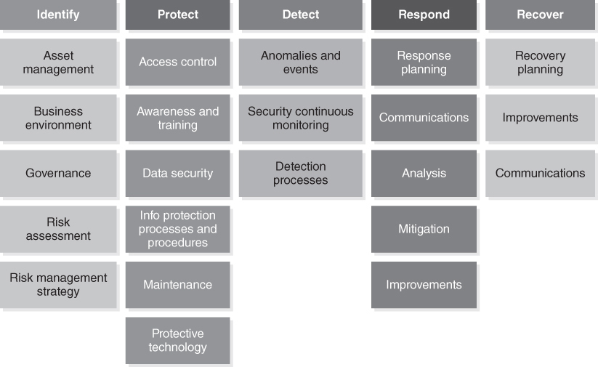
Security Management Requirements
FIGURE 11-13 NIST Cybersecurity Framework (CSF) v1.1.
Data from https://www.nist.gov/cyberframework.
Notes:
Security management requirements align nicely to the NIST Cybersecurity Framework (CSF) v1.1.
Each CSF pillar—Identify, Protect, Detect, Respond, and Recover—is part of security management.

Slide 44
WAN Solutions for the Enterprise
High-speed Internet access (scalable business-grade Internet access)
Secure network connections (behind an IP stateful firewall)
NAT with private IP addressing (10.x.x.x /16)
VLAN capability for departmental LANs
Financial analysis for WAN bandwidth versus cost
Dynamic Multipoint Virtual Private Network (DMVPN)
Bandwidth rate limiting and threshold setting for Internet
SD-WAN to control and manage a hybrid WAN environment
Wireless access with WPA2-Enterprise for mobile devices throughout the enterprise environment
IP stateful firewall (ideally with an IDS/IPS)
Remote access with VPN and multifactor authentication
Web content filter (URL monitor and filter)

Slide 45
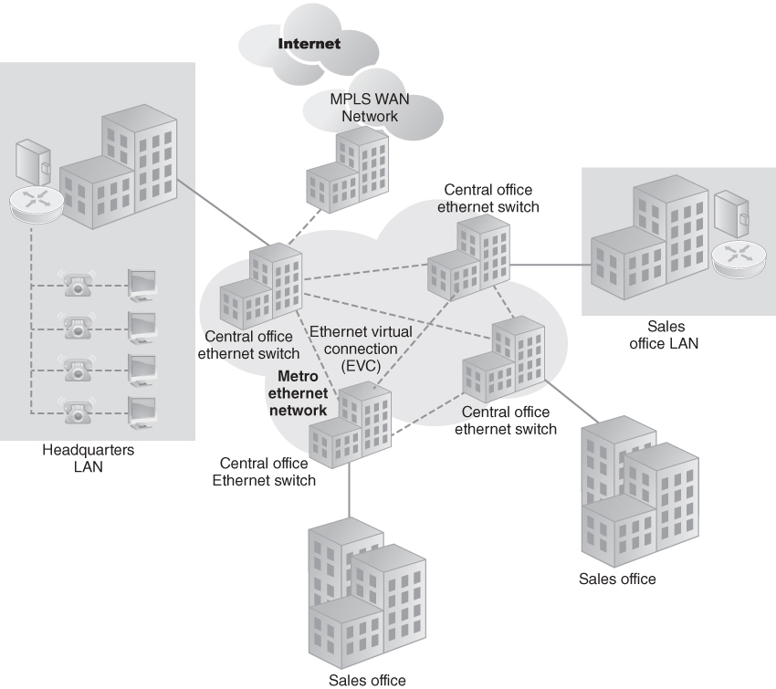
Sample Enterprise WAN Network Diagram
Figure 11-14 Sample enterprise WAN network diagram.

Slide 46
WAN Solutions for the Small to Medium Business (SMB)
High-speed Internet access (scalable business-grade Internet access)
Secure network connections (behind an IP stateful firewall)
NAT with private IP addressing (172.16.x.x /12)
VLAN segmentation to logically separate departmental LANs and traffic
Public-facing DMZ/VLAN
Extension of Layer 2 networks
Connectivity to data centers or cloud hosting facilities
Point-to-Point Protocol (PPP)
Remote access with VPN and multifactor authentication
Web content filter (URL monitor and filter)

Slide 47
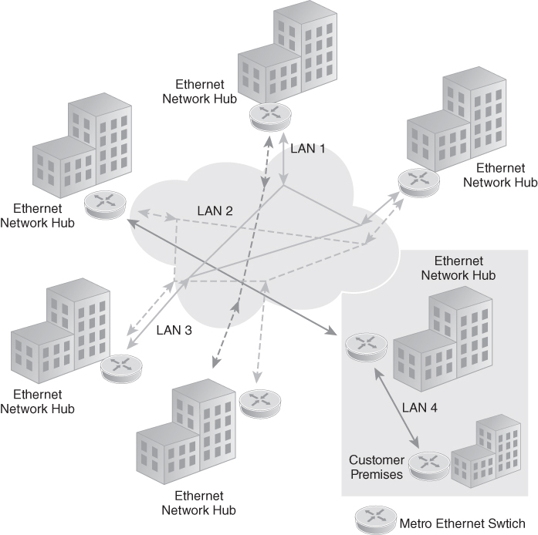
Sample SMB Metro Ethernet Network Diagram
FIGURE 11-15 Sample SMB Metro Ethernet network diagram.
Data from http://t1town.com /data-services/metro-ethernet/.

Slide 48
WAN Solutions for the Small Office/Home Office (SOHO)
High-speed Internet access (scalable business-grade Internet access)
Secure network connection (behind an IP stateful firewall)
NAT with private IP addressing (192.168.x.x /8)
VLAN capability to logically segment office/work LAN from guest/family LAN
Bandwidth rate limiting and threshold setting for guest/family LAN to Internet
Wireless access with WPA2-Enterprise for mobile devices throughout the home
IP stateful firewall (ideally with an IDS/IPS)
Remote access with VPN and multifactor authentication
Web content filter (URL monitor and filter)

Slide 49
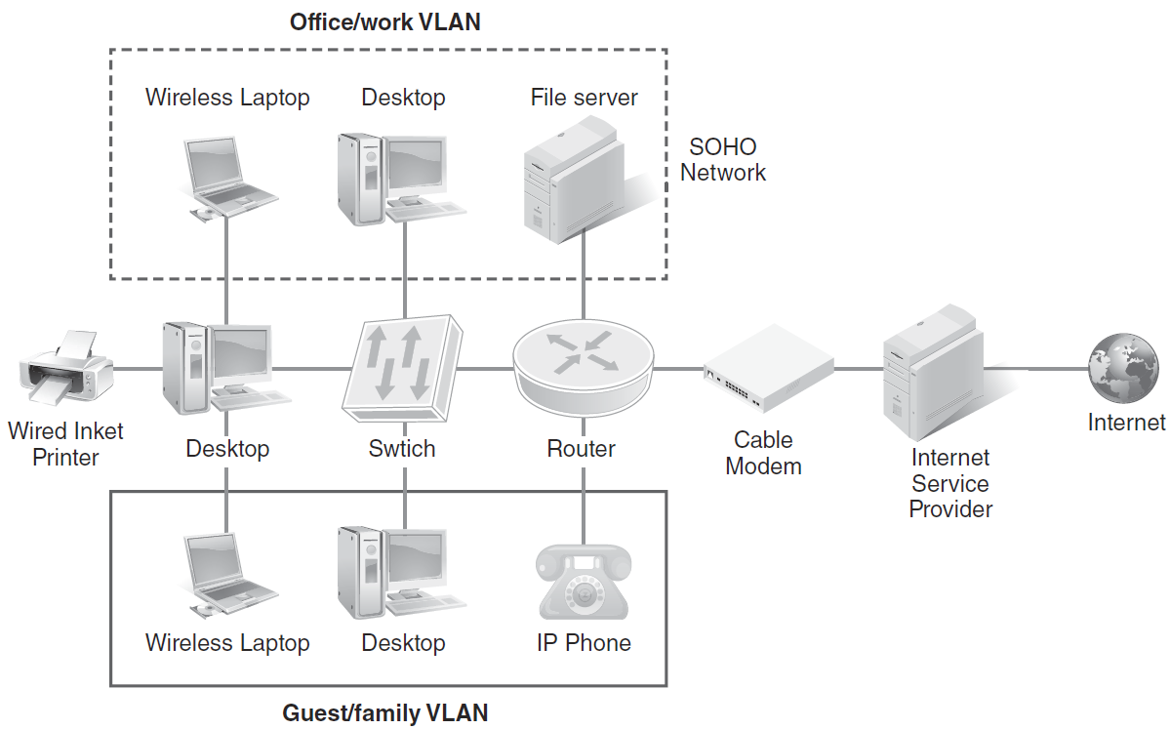
Sample SOHO Network Diagram
FIGURE 11-16 SOHO WAN scenario.

Slide 50
Summary
Wide area network (WAN) business drivers
WAN technologies
WAN solutions for enterprise, small to medium business (SMB), and small office/home office (SOHO) organizations

